Slide 1
GCSE Mathematics
Problem Solving
Algebra
Higher Tier

Slide 2
The curve y = x² +2x - 15 intersects the x axis at points A and B. Find the length of the line AB?
To find the length of AB you need to know the coordinates of A and B
Next consider how to find the coordinates of the points A and B
When the curve intersects the x-axis y = 0.
Therefore,
0 = x² +2x - 15
Solve the quadratic equation to find the values for x that satisfy the equation.

Slide 3
0 = x² +2x - 15
The first step in solving this equation is to factorise.
What two terms multiply to make x² ?
( )( )
x
+ 5
x
- 3
What two numbers multiply to make -15 and add to give + 2?
x – 15
1 x – 15
-1 x 15
3 x -5
-3 x 5
Add + 2
-14
14
-2
2

Slide 4
0 = (x + 5)(x – 3)
So,
x + 5 = 0 or x – 3 = 0
If
x + 5 = 0 then x = -5
These values are the x coordinates for A and B. The y coordinates will be ‘0’ for both A and B
If
x - 3 = 0 then x = 3
A ( -5, 0) B(3, 0)
Sketch the curve y = x² +2x – 15 to help find the length of the line AB

Slide 5
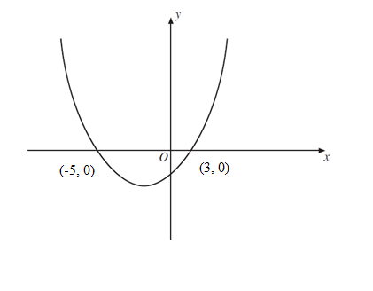
Both points lie on the x axis, so we can see from the sketch that the distance between the points (-5,0) and (3,0) is the difference between the x coordinates. So AB is equal to 8 units.

